Slide 1

ATLIQ HARDWARE REPORT

Slide 2

INTRODUCTION
AtliQ Hardware is a computer peripherals and hardware manufacturer in India like PCs, mice, printers, etc.
It has head office in Delhi and many regional offices across India.
They have many clients and stores throughout India.

Slide 3

PROBLEM STATEMENT
Mr. Bhavin Patel is sales director of AtliQ Hardware and he is facing a lot of problems in business.
Due to dynamically growing market ,he is lacking in tracking the sales and insights of business.

Slide 4

ACTIONS
Sales Director ( Mr. Bhavin Patel) has decided to invest in data analysis project and meet up with the teams to start the project.
Sales Director
Marketing Team
Customer Service Team
IT team
Data analytics team

Slide 5
AIIMS GRID
Purpose
Stakeholders
End result
Success Criterion

Slide 6

SALES DATASETS
• Data consists of five tables
Sales customers
Sales date
Sales Markets
Sales Products
Sales transactions

Slide 7
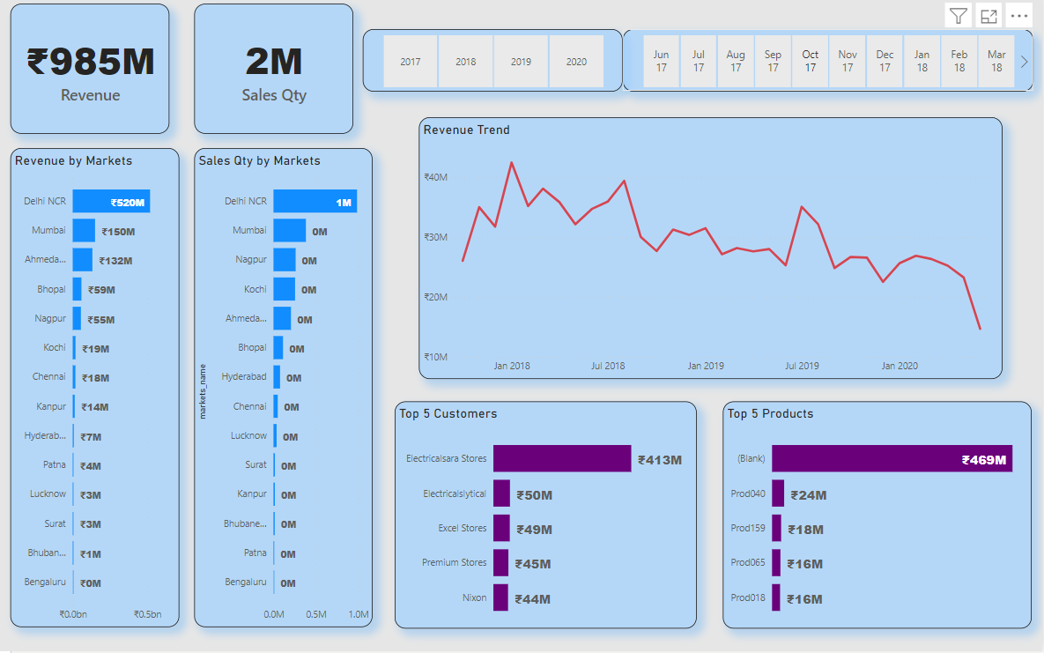

Slide 8

KEY INSIGHTS
Total revenue generated 985 million and total sales quantity is 2 million.
Total profit margin is 24.7 million. Delhi NCR is topmost in revenue and profit contribution with 54.7%
Electricalsara stores is the top customer with 42% revenue contribution and 37.7% profit contribution
North zone has maximum sales with 676 million and south has least sales with 46millions

Slide 9

THANK YOU

